Slide 1
EC3357:Machine Learning
Lecture 8 : Dimensionality Reduction

Slide 2
Overview
Data reduction techniques can be applied to achieve a reduced representation of the data set.
The goal is to provide the mining process with a mechanism to produce the same (or almost the same) outcome when it is applied over reduced data instead of the original data.

Slide 3
Introduction
In machine learning, the performance of a model only benefits from more features up until a certain point.
The more features are fed into a model, the more the dimensionality of the data increases.
As the dimensionality increases, overfitting becomes more likely.
Overfitting in machine learning refers to a scenario where a model learns the training data too well, to the extent that it captures not only the underlying patterns but also the noise or random fluctuations present in the data. This results in a model that performs extremely well on the training data but generalizes poorly to new, unseen data.
There are multiple techniques that can be used to fight overfitting, but dimensionality reduction is one of the most effective techniques.
Dimensionality reduction selects the most important components of the feature space, preserving them and dropping the other components.

Slide 4
The Curse of Dimensionality
Dimensionality becomes a serious obstacle for the efficiency of most of the Data Mining algorithms.
It has been estimated that as the number of dimensions increase, the sample size needs to increase exponentially in order to have an effective estimate of multivariate densities.

Slide 5
Dimensionality of input
Number of Observables (e.g. age and income)
If number of observables is increased
More time to compute
More memory to store inputs and intermediate results
More complicated explanations (knowledge from learning)
Regression from 100 vs. 2 parameters
No simple visualization
2D vs. 10D graph
Need much more data (curse of dimensionality)
1M of 1-d inputs is not equal to 1 input of dimension 1M

Slide 6
Dimensionality reduction
Some features (dimensions) bear little or nor useful information (e.g. color of hair for a car selection)
Can drop some features
Have to estimate which features can be dropped from data
Several features can be combined together without loss or even with gain of information (e.g. income of all family members for loan application)
Some features can be combined together
Have to estimate which features to combine from data

Slide 7
Dimensionality Reduction: Feature Selection vs Extraction
Feature selection and feature extraction are two different approaches to achieve dimensionality reduction, which is the process of reducing the number of features (variables) in a dataset while retaining as much relevant information as possible.
Both techniques aim to address the curse of dimensionality, where datasets with a large number of features can lead to increased complexity, computational costs, and potential overfitting.

Slide 8
Feature Selection:
Involves selecting a subset of the most important features from the original set of features.
The goal is to keep the most relevant and informative features from the original features while discarding the less important ones.
Feature selection methods assess the importance of individual features or subsets of features based on some criteria, and then eliminate the features that contribute the least to the predictive power of the model.
when model explainability is a key requirement.
Feature selection: Choosing k<d important features, ignoring the remaining d – k
Subset selection algorithms

Slide 9
Feature Extraction
Feature extraction involves transforming the original features into a new set of features that represent the data in a more compact and informative way.
These new features are usually a combination of the original features and are designed to capture the underlying patterns or structure in the data.
Feature extraction: Project the original x_{i} , i =1,...,d dimensions to new k<d dimensions, z_{j} , j =1,...,k

Slide 10
“Goodness” of feature set
In supervised learning, the goal is to predict a target variable based on input features.
Dimensionality reduction techniques in supervised learning are used to improve the efficiency and effectiveness of predictive models by reducing noise, enhancing interpretability and potentially speeding up training.
In unsupervised learning, the goal is to find patterns and structures within the data without using any labeled target information.
Dimensionality reduction techniques in unsupervised learning are primarily used for data visualization, clustering, and noise reduction.
In unsupervised learning, dimensionality reduction often aims to reveal inherent patterns and structures, while in supervised learning, it focuses on improving the performance of predictive models by reducing noise and complexity.

Slide 11
Subset selection
Have initial set of features of size d
There are 2^d possible subsets. Can’t go over all 2^d possibilities
Need a criteria to decide which subset is the best
A way to search over the possible subsets
Need some heuristics.

Slide 12
Heuristic methods in subset selection
Practical and intuitive approaches used in subset selection problems to find a good or near-optimal solution without exhaustively exploring all possible combinations.
These methods are particularly useful when dealing with large datasets and complex optimization problems, as they provide a balance between computational efficiency and solution quality.
Forward Search, Backward Search, Floating search

Slide 13
Heuristic methods
Forward Search:
This method starts with an empty subset and iteratively adds features one by one. At each step, it selects the feature that improves the model performance the most (according to a predefined criterion). The process continues until a stopping criterion is met.
Backward Search:
Similar to forward selection, this method starts with all features and iteratively removes one feature at a time. At each step, it removes the feature that has the least impact on the model's performance.
Floating Search:
These methods combine elements of forward and backward selection. They involve adding and removing features iteratively based on a criterion, and they allow features to be swapped in and out during the process.

Slide 14

Feature Extraction
Find a projection matrix w from d-dimensional to k-dimensional vectors that keeps error low.
Refers to the process of finding a projection matrix that transforms data from a higher-dimensional space to a lower-dimensional space, such that the loss of information (error) is minimized.
This equation is fundamental in the context of feature extraction, particularly in techniques like Principal Component Analysis (PCA) and Linear Discriminant Analysis (LDA).

Slide 15
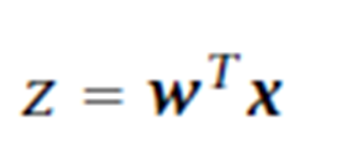
Z: Z represents the transformed data in the lower-dimensional space. Each row of Z corresponds to a transformed data point after the projection.
w: w is the projection matrix. It's a matrix that defines the transformation from the original high-dimensional space to the lower-dimensional space.
X: X is the original high-dimensional data matrix. Each row of X represents a data point, and each column represents a feature.
w^{T}: w^{T} represents the transpose of the projection matrix w. Transposing a matrix essentially flips its rows and columns. Transposing w allows us to apply the projection in the desired way.

Slide 16
Dimensionality Reduction
Some of the Dimensionality Reduction methods:
Principal Components Analysis (PCA)
Linear Discriminant Analysis (LDA)
Factor Analysis (FA)

Slide 17
Principal Components Analysis
Find a set of linear transformations of the original variables which could describe most of the variance using a relatively fewer number of variables.
It is usual to keep only the first few principal components that may contain 95% or more of the variance of the original data set.
PCA is useful when there are too many independent variables and they show high correlation.

Slide 18
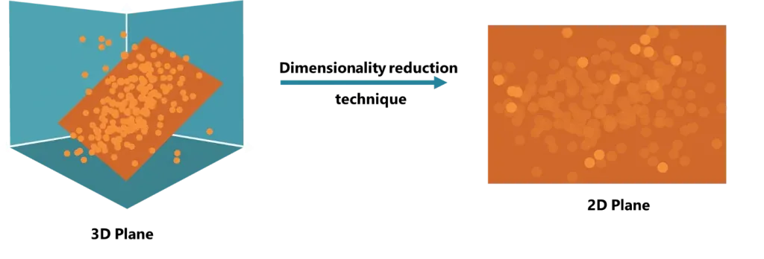
Example

Slide 19
This plane is two-dimensional, so it is defined by two variables. As you can see, not all points lie on this plane, but we can say that they approximately do.
Linear algebraic operations allow us to transform this 3-dimensional data into 2-dimensional data. Of course, some information is lost, but the total number of features is reduced.
In this way, instead of having 3 variables, we reduce the problem to 2 variables.
In fact, if you have 50 variables, you can reduce them to 40, or 20, or even 10. And that’s where dimensionality reduction has the biggest impact.

Slide 20
PCA: Motivation
Assume that d observables are linear combination of k<d vectors
z_{i}=w_{i1}x_{i1}+…+w_{ik}x_{id}
The expression describes how each new feature z_{i} is formed as a linear combination of the original features x_{ij}
X is Original Data Matrix
W is Transformation Matrix
Z is New Data Matrix

Slide 21
We would like to work with basis as Z has lesser dimension and have all(almost) required information
What we expect from such basis that the principals are
uncorrelated or otherwise can be reduced further
have large variance (e.g. w_{i1} have large variation) or otherwise bear no information

Slide 22
Principal Component Analysis (PCA)
Find a projection that captures the largest amount of variation in data
The original data are projected onto a much smaller space, resulting in dimensionality reduction. We find the eigenvectors of the covariance matrix, and these eigenvectors define the new space
x₂
e
x₁

Slide 23
Principal Component Analysis(PCA) is one of the most popular linear dimension reduction algorithms. It is a projection based method that transforms the data by projecting it onto a set of orthogonal (perpendicular) axes.
PCA works on a condition that while the data in a higher-dimensional space is mapped to data in a lower dimension space, the variance or spread of the data in the lower dimensional space should be maximum.
Principal Component Analysis selects the "principal" or most influential characteristics of the dataset and creates features based on them. By choosing only the features with the most influence on the dataset, the dimensionality is reduced.
PCA preserves the correlations between variables when it creates new features. The principal components created by the technique are linear combinations of the original variables, calculated with concepts called eigenvectors.
It is assumed that the new components are orthogonal, or unrelated to one another.

Slide 24
Principal Components Analysis
Procedure:
Normalize input data-Each attribute falls within the same range
Compute k orthonormal vectors (principal components).
Sort the PCs according to their strength, given by their eigenvalues.
Reduce data by removing weaker components (i.e., those with low variance )

Slide 25
Normalization
Min-max normalization: to [new_min_{A}, new_max_{A}]
Ex. Let income range $12,000 to $98,000 normalized to [0.0, 1.0]. Then $73,000 is mapped to
Z-score normalization (μ: mean, σ: standard deviation):
Ex. Let μ = 54,000, σ = 16,000. Then
Normalization by decimal scaling
Where j is the smallest integer such that Max(|ν’|) < 1

Slide 26
Some common terms used in PCA algorithm:
Dimensionality: It is the number of features or variables present in the given dataset. More easily, it is the number of columns present in the dataset.
Correlation: It signifies that how strongly two variables are related to each other. Such as if one changes, the other variable also gets changed. The correlation value ranges from -1 to +1. Here, -1 occurs if variables are inversely proportional to each other, and +1 indicates that variables are directly proportional to each other.
Orthogonal: It defines that variables are not correlated to each other, and hence the correlation between the pair of variables is zero.
Eigenvectors: If there is a square matrix M, and a non-zero vector v is given. Then v will be eigenvector if Av is the scalar multiple of v.
Covariance Matrix: A matrix containing the covariance between the pair of variables is called the Covariance Matrix.

Slide 27
Eigenvector
Eigenvectors are a fundamental concept in linear algebra, particularly when dealing with square matrices.
An eigenvector of a square matrix A is a non-zero vector that, when multiplied by the matrix, yields a scaled version of itself. In mathematical terms, if v is an eigenvector of matrix A and λ (lambda) is a scalar, then:
A * v = λ * v
A: This is the square matrix for which we're seeking eigenvectors.
v: This is the eigenvector we're looking for. It's a non-zero vector that, when transformed by matrix A, only changes in magnitude (by the factor λ) but maintains its direction.
λ (lambda): This is the eigenvalue associated with the eigenvector v. It's the scalar value by which the eigenvector is scaled during the matrix-vector multiplication. Each eigenvector has a corresponding eigenvalue.

Slide 28
Principal Components in PCA
As described above, the transformed new features or the output of PCA are the Principal Components. The number of these PCs are either equal to or less than the original features present in the dataset. Some properties of these principal components are given below:
The principal component must be the linear combination of the original features.
These components are orthogonal, i.e., the correlation between a pair of variables is zero.
The importance of each component decreases when going to 1 to n, it means the 1 PC has the most importance, and n PC will have the least importance.
Try the example below:
https://stackabuse.com/dimensionality-reduction-in-python-with-scikit-learn/

Slide 29
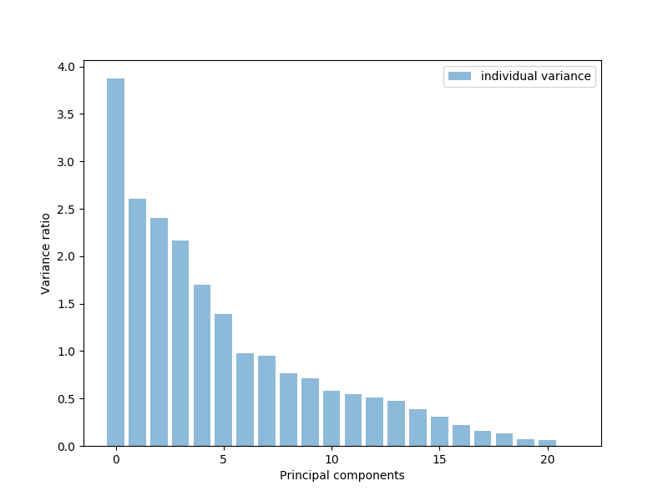

Slide 30
Steps for PCA algorithm
Getting the dataset
Representing data into a structure
Standardizing the data (x by subtracting the mean and dividing by the standard deviation for each feature This results in a dataset where each feature has a mean of 0 and a standard deviation of 1. )
x = StandardScaler().fit_transform(x) (Python)
Calculating the Covariance of Z
Calculating the Eigen Values and Eigen Vectors
Sorting the Eigen Vectors
Calculating the new features Or Principal Components. ((pca.explained_variance_ratio_) (Python)
Remove less or unimportant features from the new dataset.

Slide 31
https://jakevdp.github.io/PythonDataScienceHandbook/05.09-principal-component-analysis.html
https://builtin.com/machine-learning/pca-in-python
https://stackabuse.com/dimensionality-reduction-in-python-with-scikit-learn/
https://builtin.com/machine-learning/pca-in-python
https://365datascience.com/tutorials/python-tutorials/principal-components-analysis/
Try the last one.

Slide 32
Factor Analysis: Overview
What is Factor Analysis? (purpose)
History
Assumptions
Steps
Reliability Analysis
Creating Composite Scores

Slide 33
What is Factor Analysis?
Factor analysis is a statistical technique used to identify underlying relationships between variables by reducing a large number of observed variables into a smaller set of unobserved factors.
A family of techniques to examine correlations amongst variables.
Uses correlations among many items to search for common clusters.
Aim is to identify groups of variables which are relatively homogeneous.
Groups of related variables are called ‘factors’.
Involves empirical testing of theoretical data structures

Slide 34
Purposes
The main applications of factor analytic techniques are:
to reduce the number of variables
to detect structure in the relationships between variables, that is to classify variables.
Notes:
http://www.statsoft.com/textbook/stfacan.html

Slide 35
Conceptual Model for a Factor Analysis with a Simple Model
Factor 1
Factor 2
Factor 3
12 items testing might actually tap
only 3 underlying factors
Notes:
Arrows represent single items (or variables) on a test/survey/questionnaire.
The circles represent factors, i.e., the shared variance amongst different sets of related items.

Slide 36
Eysenck’s Three Personality Factors
Extraversion/
introversion
Neuroticism
Psychoticism
talkative
fun
anxious
tense
loner
shy
sociable
gloomy
harsh
nurturing
relaxed
unconventional
12 items testing three underlying dimensions of personality

Slide 37
Conducting Factor Analysis
Problem formulation
Check Suitability
Method of Factor Analysis
Determination of Number of Factors
Rotation of Factors
Interpretation of Factors
Calculation of
Factor Scores
Determination of Model Fit

Slide 38
Formulate the Problem
The objectives of factor analysis should be identified.
The variables to be included in the factor analysis should be specified. The variables should be measured on an interval or ratio scale.
An appropriate sample size should be used. As a rough guideline, there should be at least four or five times as many observations (sample size) as there are variables.

Slide 39
Check suitability
The analytical process is based on a matrix of correlations between the variables.
If the Bartlett's test of sphericity is not rejected, then factor analysis is not appropriate.
If the Kaiser-Meyer-Olkin (KMO) measure of sampling adequacy is small, then the correlations between pairs of variables cannot be explained by other variables and factor analysis may not be appropriate.

Slide 40
Determine the Method of Factor Analysis
In Principal components analysis, the total variance in the data is considered.
-Used to determine the min number of factors that will account for max variance in the data.
In Common factor analysis, the factors are estimated based only on the common variance.
-Communalities are inserted in the diagonal of the correlation matrix.
-Used to identify the underlying dimensions and when the common variance is of interest.

Slide 41
Determine the Number of Factors
A Priori Determination. Use prior knowledge.
Determination Based on Eigenvalues. Only factors with Eigenvalues greater than 1.0 are retained.
Determination Based on Scree Plot. A scree plot is a plot of the Eigenvalues against the number of factors in order of extraction. The point at which the scree begins denotes the true number of factors.
Determination Based on Percentage of Variance.

Slide 42
Rotation of Factors
Through rotation the factor matrix is transformed into a simpler one that is easier to interpret.
After rotation each factor should have nonzero, or significant, loadings for only some of the variables. Each variable should have nonzero or significant loadings with only a few factors, if possible with only one.
The rotation is called orthogonal rotation if the axes are maintained at right angles.

Slide 43
Rotation of Factors
Varimax procedure. Axes maintained at right angles
-Most common method for rotation.
-An orthogonal method of rotation that minimizes the number of variables with high loadings on a factor.
-Orthogonal rotation results in uncorrelated factors.
Oblique rotation. Axes not maintained at right angles
-Factors are correlated.
-Oblique rotation should be used when factors in the population are likely to be strongly correlated.

Slide 44
Interpret Factors
A factor can be interpreted in terms of the variables that load high on it.
Another useful aid in interpretation is to plot the variables, using the factor loadings as coordinates. Variables at the end of an axis are those that have high loadings on only that factor, and hence describe the factor.

Slide 45
Calculate Factor Scores
The factor scores for the i th factor may be estimated as follows:
F_{i} = W_{i1} X₁ + W_{i2} X₂ + W_{i3} X₃ + . . . + W_{ik} X_{k}

Slide 46
Determine the Model Fit
The correlations between the variables can be deduced from the estimated correlations between the variables and the factors.
The differences between the observed correlations (in the input correlation matrix) and the reproduced correlations (estimated from the factor matrix) can be examined to determine model fit. These differences are called residuals.

Slide 47
https://www.google.com/aclk?sa=l&ai=DChcSEwiYtrqQ3ZiMAxVWjEsFHVNxNOwYABAAGgJzZg&co=1&gclid=Cj0KCQjw-e6-BhDmARIsAOxxlxVKv10Gtdb_dF2tNRZ4l0tzfro4TNGcv5KRSqsZ2YSmMc7bvgca-TwaAsI6EALw_wcB&sig=AOD64_2IbGIbDQQSlFXDc083OXHwW9ajUA&q&adurl&ved=2ahUKEwjo77WQ3ZiMAxUnSGcHHTXJNtEQ0Qx6BAgMEAE

Slide 48
Understanding Each Column:
Factor1, Factor2, Factor3, Factor4, Factor5
These are the five extracted factors, each representing a group of related variables.
SS Loadings (Sum of Squared Loadings)
These are the eigenvalues of each factor.
The eigenvalue represents how much variance is explained by a given factor.
Higher SS Loadings mean the factor explains more variance.
Proportion Var (Proportion of Variance Explained)
Shows the percentage of total variance explained by each factor.
Example: Factor1 explains 9.89% of the variance, Factor2 explains 10.84%, etc.
Cumulative Var (Cumulative Variance Explained)
The total variance explained by all extracted factors up to that point.
Factor1 explains 9.89%.
Factor1 + Factor2 together explain 20.73%.
Factor1 + Factor2 + Factor3 together explain 28.89%, and so on.
By the time we reach Factor5, the total variance explained is 42.36%.

Slide 49
Key Interpretation:
The five factors together explain 42% of the total variance in the dataset.
This means that 42% of the information in the original dataset is retained in these five factors.
The remaining 58% of the variance is due to unexplained or unique factors (noise, measurement errors, or other hidden variables).

Slide 50
What Does This Mean for Your Analysis?
If 42% variance explained is acceptable, you can proceed with these five factors.
If higher variance explanation is needed (e.g., 60-70%), consider extracting more factors or improving your model.
Typically, in social sciences, explaining 40-60% variance is considered good.

